Slide 1
ROBOTIC FUNDAMENTALS
(UMFM4X-15-M)
Velocity Kinematics

Slide 2

Previously on
Workspace of a robot – examples on how to calculate it
Inverse kinematics – redundant solutions due to the trigonometric functions
Iterative solutions slower and out of scope (but possibly the ONLY solution for some problems – Parallel Robots)
Closed form solutions (a.k.a. analytical) give information about the entire configuration of a manipulator
Test your skills on DH
Questions?

Slide 3
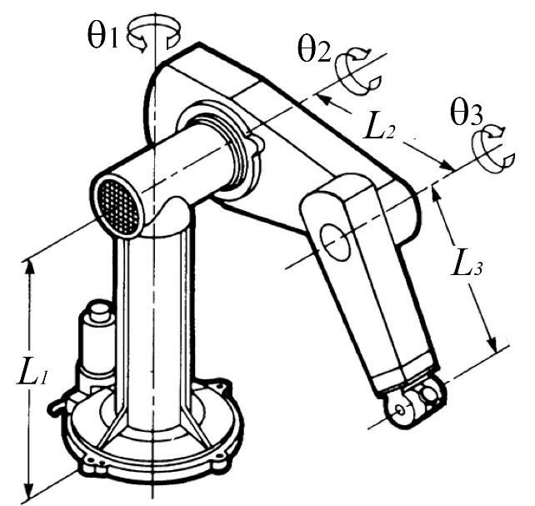
Test your skills on DH - exercises
Standard (distal) DH convention
Modified (proximal) DH convention
d₂
d₂
z₁
z₂
z₁
x₂
z₃
z₂
x₁
X_{1,}
x₂
x₃
z₀
z₀
z_{e}
z₃
x₃
x_{e}
x₀
x₀
n | a_{n-1} | a_{n-1} | d_{n} | θ_{n}
1 | 0 | 0 | L₁ | θ₁
2 | 0 | -90º | d₂ | θ₂
3 | L₂ | 0 | 0 | θ₃
e | L₃ | 0 | 0 | 0
n | a_{n} | a_{n} | d_{n} | θ_{n}
1 | 0 | -90º | L₁ | θ₁
2 | L₂ | 0 | d₂ | θ₂
3 | L₃ | 0 | 0 | θ₃

Slide 4
Test your skills on DH - exercises
When filling out the DH table, make sure all robot characteristics are included. For example, when using the proximal convention, you might have to place frame {0} and frame {1} at different origins.
You should always have a frame {0}. In proximal, this is the base frame (before the first joint). In distal, this is the frame of the 1st joint.
Do not forget indices! Do not simply write x, y, z, a, α, d, θ. Indicate what frame the belong to e.g. a_{i} or a_{i-1} and x₂/x₃ etc.
When showing the DH frames, it is advisable not to draw the robot in the ‘home’ position. In the ‘home’ position, x axes of consecutive joints align and therefore the true direction of the x axes will not be shown (e.g. in distal, the x-axis of a joint will follow the movement of the immediately previous link, while in proximal, it will follow the movement of the link following the joint.
Confusion about the two conventions: when using one convention, stick with it. E.g. do not place frames according to proximal and then make a distal DH table.

Slide 5
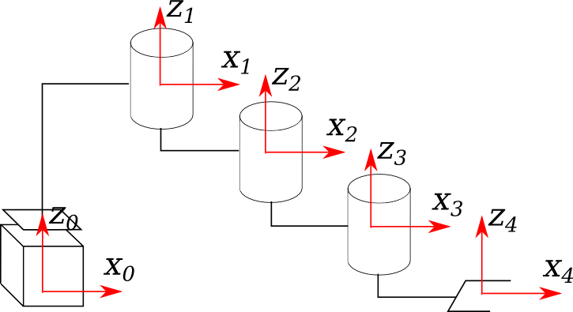
Test your skills on DH - exercises
Lengths are in m:
n | a_{n} | a_{n} | d_{n} | θ_{n}
1 | 1 | 0 | d | 0
2 | 1 | 0 | -0.3
3 | 1 | 0 | -0.15
4 | 1 | 0 | -0.15
100cm

Slide 6
Test your skills on DH - exercises
It is better to not start the indices of ‘θ’ from 0. Both proximal and distal DH tables start from i=1, e.g, θ₁…θ_{n}.
In some cases, the direction of ‘θ’ will be indicated in the drawing: place the z axis of the joint according to the right hand rule. This might be important, depending on application.
Do not forget that prismatic joints are joints! They will have a ‘d’ parameter which is variable. Generally, each row of a DH table represents one DOF and should usually contain only one variable (d or θ).
Pay attention to the definition of each parameter. E.g. ‘d’ is measured from x_{i-1} to x_{i} along the direction z_{i-1}(distal) or z_{i}(proximal). This means that, depending on the location of the two x axes and the direction that the z axis is pointing, it can be positive or negative

Slide 7
Today’s Lecture
Velocities and Accelerations
The Jacobian
Differential Motion
Singular Matrix – Singularities
A glimpse in Dynamics

Slide 8
The Problem
How do we relate
end-effector linear and angular velocities
to
joint velocities?

Slide 9
Velocities and accelerations
Velocity Kinematics

Slide 10
Velocities – Linear and Angular
A
Angular velocity
0
Fixed length link, pivoted at one end

Slide 11
Accelerations
Acceleration is the time rate of change (derivative) of velocity
Angular acceleration
A
The normal component represents the time rate of change in the direction of the velocity.
The tangential component represents the time rate of change in the magnitude of the velocity.
0
Notes:
Theta double dot is the angular acceleration

Slide 12
Velocity propagation (link to link)
Chain of links - at any instant a link has a linear and/or angular velocity component
Propagation of velocities from the frame {O₀} to the end effector
For most manipulators we will want to find the angular velocity of one frame due to the rotations of multiple frames. Consider two frames O₁, O₂ with rotation matrix
Their angular velocities are related as:
  Angular velocities can be added once they are projected into the same coordinate frame.

Slide 13
Velocity propagation (link to link) (2)
Angular velocities can be added once they are projected into the same coordinate frame.
This can be extended to calculate the angular velocity for an n-link manipulator:
  Suppose we have an n-link manipulator whose coordinate frames are related as follows:
  We can define the angular velocity of the tool frame (n) in the base frame (0):
Angular velocity of point
attached to frame n (on link n)
due to the rotation of frame {n-1}
(also expressed in frame {n-1}

Slide 14
Linear velocities
The linear velocity of any point on a rigid body is the sum of the linear velocity of the rigid body and the velocity of the particle due to rotation of the rigid body.
The linear velocity of the end effector can be due to the motion of revolute and/or prismatic joints.
First, the position of a point p attached to a rigid body is:
To find the velocity, take the derivative as follows:

Slide 15
Linear velocity of links
Frames are attached to each joint
Frame 1 does not translate with respect to 0 frame. Because Link 1 rotates, frame {1} has a linear velocity with respect to the reference frame {0}
Linear velocity of Link 2 due to rotation of Link 2 around reference frame {1}:
y₂
x₂
y₀
y₁
Link 2
θ2
x₁
Link 1
θ1
x₀
Angular velocity due
to rotation of L2
expressed in frame {1}
THIS IS A SCALAR CALCULATION

Slide 16
Linear velocity of links
y₂
x₂
In general for revolute joints stands:
y₀
y₁
Link 2
θ2
x₁
Link 1
THIS IS A VECTOR CALCULATION
θ1
x₀
Velocities have to be expressed in relation to the same frame so we can add them up.

Slide 17
Acceleration – Angular
Angular acceleration of joint i + Coriolis acceleration + acceleration of joint i+1

Slide 18
Acceleration – Linear
Linear acceleration of frame
Linear acceleration of frame i +
+ normal and tangential components of Link i+1,
in respect to frame i
Linear acceleration of the centre of mass

Slide 19
The jacobian
Differential Motion and Jacobian

Slide 20

Differential motion
Forward kinematics $q →X$
Differential motion $q+δq →X+δX$
Which is a link between velocities: $\dot{q}→\dot{X}$
A relationship described by the Jacobian matrix
Notes:
q is the joint vector, e.g. for an RRR manipulator q = [θ₁ θ₂ θ₃]
X is the Cartesian vector [x y z]

Slide 21

End effector vs joint velocities
$$\dot{X}=J\left(q\right)\dot{q}$$
End position velocity
Joint velocity
Jacobian matrix

Slide 22


The Jacobian
  Instantaneous transformation between a vector in R^{n} representing joint velocities to a vector in R⁶ representing the linear and angular velocities of the end-effector
$$\dot{X}=J\left(q\right)\dot{q}$$
The Jacobian is mapping velocities from Joint space to Cartesian space.

Slide 23

Jacobian Solutions
Jacobian matrix is of m×n dimension
(m is the number of EE position and orientation parameters and n is the number of DOFs)
Represents the partial derivatives of each EE position and orientation parameter to each joint parameter
$$J_{ij}=\frac{∂f_{i}}{∂q_{j}}$$
Notes:
EE: end effector

Slide 24
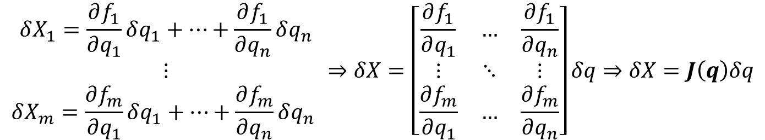

Differential motion and the Jacobian (1)
If the end-effector position and orientation are given by:
$$X=f\left(q\right)$$
then the Jacobian $J(q)$ is defined as:
$$\begin{matrix}δX_{1}=\frac{∂f_{1}}{∂q_{1}}δq_{1}+…+\frac{∂f_{1}}{∂q_{n}}δq_{n} \\ ⋮ \\ δX_{m}=\frac{∂f_{m}}{∂q_{1}}δq_{1}+…+\frac{∂f_{m}}{∂q_{n}}δq_{n} \end{matrix}⇒δX=\left[\begin{matrix}\frac{∂f_{1}}{∂q_{1}} & … & \frac{∂f_{1}}{∂q_{n}} \\ ⋮ & ⋱ & ⋮ \\ \frac{∂f_{m}}{∂q_{1}} & … & \frac{∂f_{m}}{∂q_{n}}\end{matrix}\right]δq⇒δX=J\left(q\right)δq$$

Slide 25
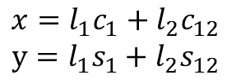

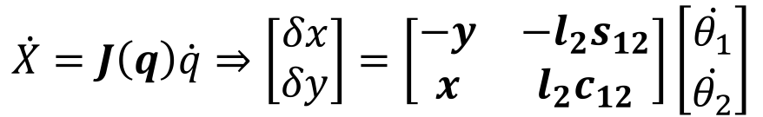
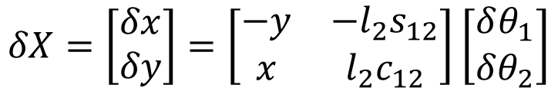
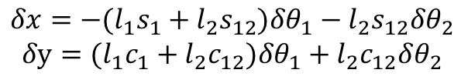
Example – 2-link Robot Jacobian
x,y
l₂
$$x=l_{1}c_{1}+l_{2}c_{12}$$
$$y=l_{1}s_{1}+l_{2}s_{12}$$
l₁
θ₂
$$δx=−{(l}_{1}s_{1}+l_{2}s_{12})δθ_{1}−l_{2}s_{12}δθ_{2}$$
$$δy={(l}_{1}c_{1}+l_{2}c_{12})δθ_{1}+l_{2}c_{12}δθ_{2}$$
θ₁
$$δX=\left[\begin{matrix}δx \\ δy\end{matrix}\right]=\left[\begin{matrix}−y & −l_{2}s_{12} \\ x & l_{2}c_{12}\end{matrix}\right]\left[\begin{matrix}δθ_{1} \\ δθ_{2}\end{matrix}\right]$$
$$\dot{X}=J\left(q\right)\dot{q}⇒\left[\begin{matrix}δx \\ δy\end{matrix}\right]=\left[\begin{matrix}−y & −l_{2}s_{12} \\ x & l_{2}c_{12}\end{matrix}\right]\left[\begin{matrix}\dot{θ_{1}} \\ \dot{θ_{2}}\end{matrix}\right]$$
At any time instant, $q$ has a certain value and $J(θ)$ is a linear transformation.
Jacobians are time-varying linear transformations

Slide 26
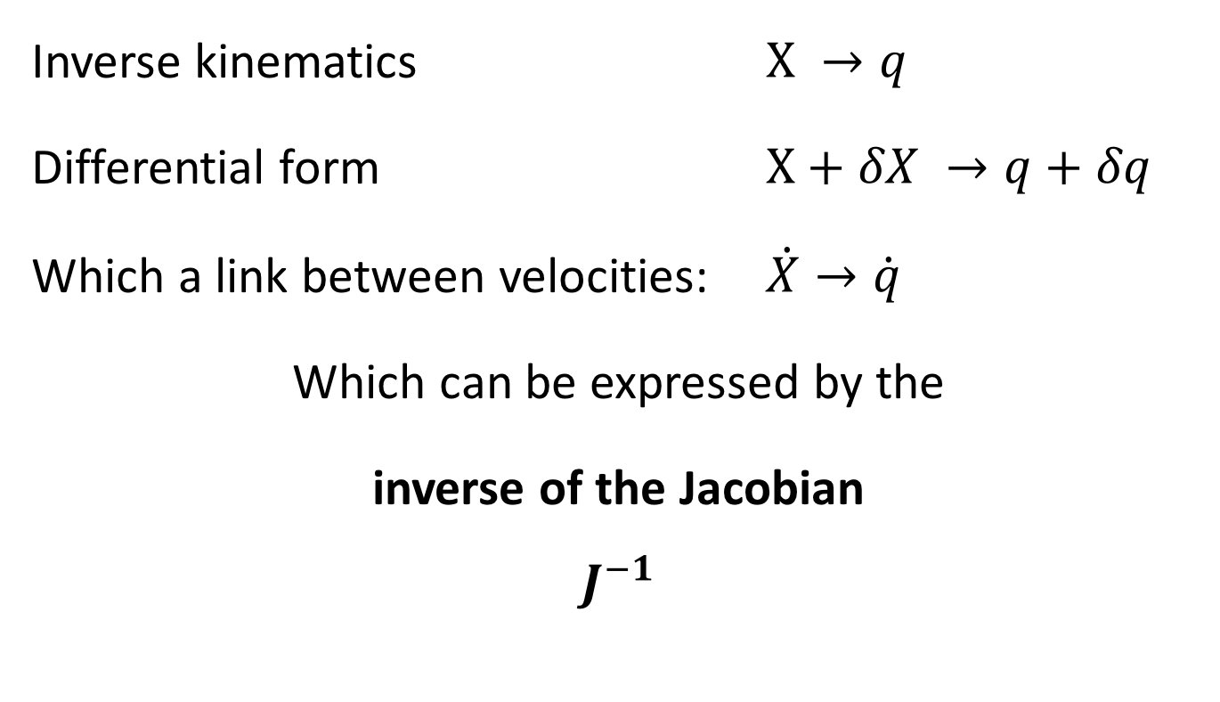
The Inverse Jacobian
Inverse kinematics $X →q$
Differential form $X+δX →q+δq$
Which a link between velocities: $\dot{X}→\dot{q}$
Which can be expressed by the
inverse of the Jacobian
$$J^{−1}$$

Slide 27
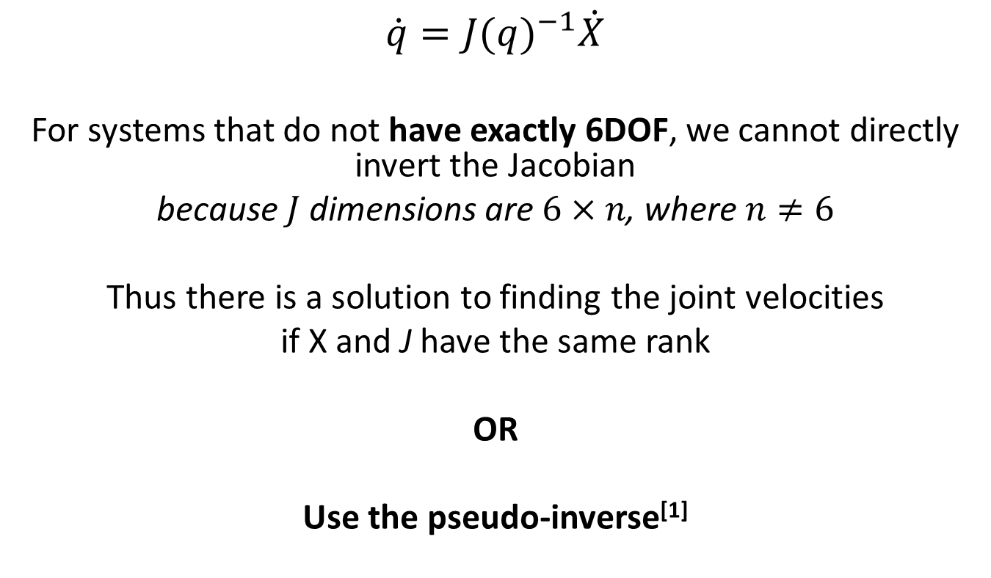
The Inverse Jacobian (2)
$$\dot{q}={J(q)}^{−1}\dot{X}$$
For systems that do not have exactly 6DOF, we cannot directly invert the Jacobian
because $J$dimensions are $6×n$, where $n≠6$
Thus there is a solution to finding the joint velocities
if X and J have the same rank
OR
Use the pseudo-inverse^{[1]}
^{[1]} R. Penrose, A generalised inverse for Matrices, 1954

Slide 28
Singularities
Differential Motion and Jacobian

Slide 29
Singular matrix
A matrix is singular if its determinant is equal to zero.

Slide 30
Singular matrix – Implications
A singular matrix cannot be inverted.
If you cannot invert a Jacobian you cannot calculate joint velocities.
These are Singularities

Slide 31
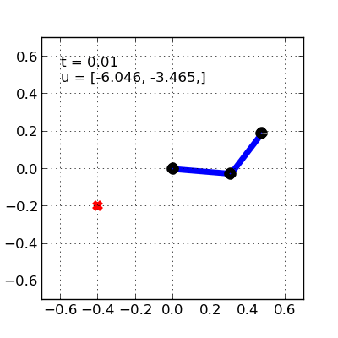
Singularity an example
Notes:
https://studywolf.wordpress.com/2013/10/10/robot-control-part-6-handling-singularities/

Slide 32

Singularity an example - fixed
Notes:
https://studywolf.wordpress.com/2013/10/10/robot-control-part-6-handling-singularities/

Slide 33
Singularities
Singularities are points in the configurations space where infinitesimal motion in a certain direction is not possible and the manipulator loses one or more degrees of freedom
When operating in a singular point small end effector velocities may correspond to large joint velocities
Singularities are often found on the extents of the workspace
Mathematically, singularities exist where the Jacobian inverse does not exist (det(J)=0).
Notes:
Mathematically, singularities exist where the Jacobian inverse does not exist (det(J)=0).

Slide 34
Singularities
Boundary singularities – manipulator outstretched or retracted. These singularities do not represent a true drawback, since they can be avoided on condition that the manipulator is not driven to the boundaries of its reachable workspace.
Internal singularities – caused by a lining up of two or more joint axes. They are more serious and happen within the workspace under certain conditions.

Slide 35
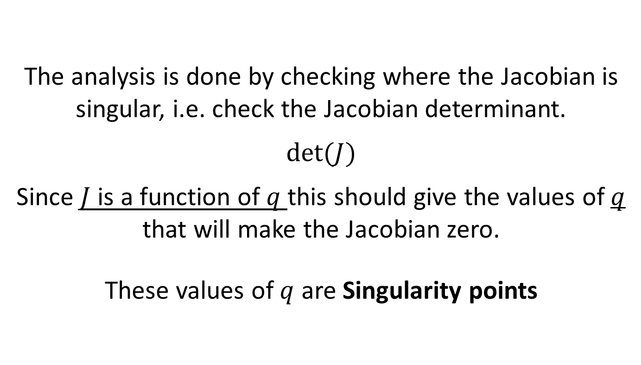
Singularity analysis
The analysis is done by checking where the Jacobian is singular, i.e. check the Jacobian determinant.
$$det⁡(J)$$
Since $J$ is a function of $q$ this should give the values of $q$ that will make the Jacobian zero.
These values of $q$ are Singularity points

Slide 36
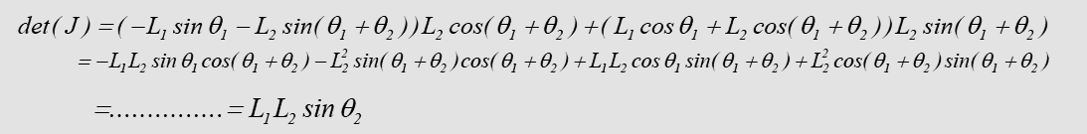
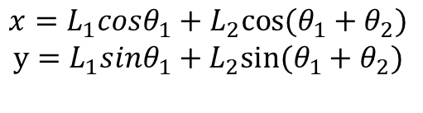

Singularity analysis – Example 2DOF
$$x=L_{1}{cosθ}_{1}+L_{2}{cos⁡(θ_{1}+θ}_{2})$$
$$y=L_{1}{sinθ}_{1}+L_{2}{sin⁡(θ_{1}+θ}_{2})$$
For a two link manipulator:
The Jacobian is:
Its determinant is:
This determinant is equal to zero when $θ_{2}$=0 or 180º. At these angles the manipulator is fully stretched or retracted.

Slide 37
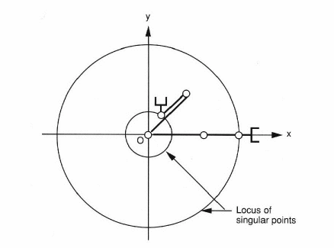
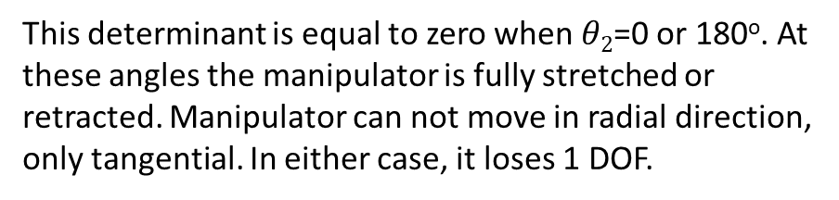
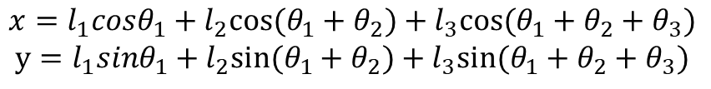
Singularity analysis – Example 3DOF
For 3 DOF manipulator:
$$x=l_{1}{cosθ}_{1}+l_{2}{cos⁡(θ_{1}+θ}_{2})+l_{3}{cos⁡(θ_{1}+θ_{2}+θ}_{3})$$
$$y=l_{1}{sinθ}_{1}+l_{2}{sin⁡(θ_{1}+θ}_{2})+l_{3}{sin⁡(θ_{1}+θ_{2}+θ}_{3})$$
^{[2]}
This determinant is equal to zero when $θ2$=0 or 180º. At these angles the manipulator is fully stretched or retracted. Manipulator can not move in radial direction, only tangential. In either case, it loses 1 DOF.
^{[2]} Amiri, M., Fathy, M. and Bayat, M., 2010. Generalization of some determinantal identities for non-square matrices based on Radic’s definition. TWMS J. Pure Appl. Math, 1(2), pp.163-175.

Slide 38
Jacobian – Force/torque relationships
Similar to the relationship between the joint velocities and the end effector velocities, we can express the relationship between the joint torques and the forces and moments at the end effector
  Important for dynamics and force control.

Slide 39
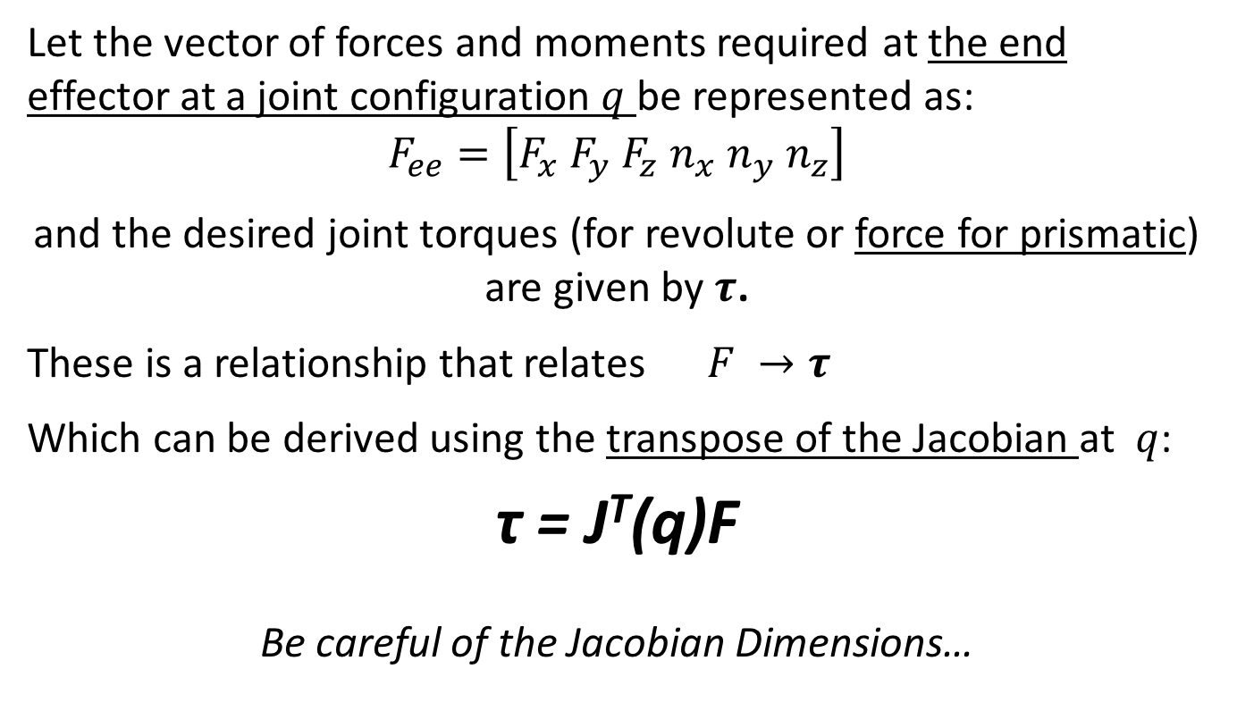
Jacobian – Force/torque relationships
Let the vector of forces and moments required at the end effector at a joint configuration $q$ be represented as:
$$F_{ee}=\left[F_{x} F_{y} F_{z} n_{x} n_{y} n_{z}\right]$$
and the desired joint torques (for revolute or force for prismatic) are given by $τ$.
These is a relationship that relates $F →τ$
Which can be derived using the transpose of the Jacobian at $q$:
τ = J^{T}(q)F
Be careful of the Jacobian Dimensions…
Notes:
Torque relates to the axis of rotation driving the rotation, while moment relates to being driven by external force(s) to cause the rotation.

Slide 40
Conclusion
Velocities, accelerations and forces propagate in serial robots
Using the Jacobian to represent this
Investigate Manipulator Singularities via the Jacobian Matrix
Simple ”Inverse Dynamics” using the Jacobian.

